Slide 1
Spirit Airline performance

Slide 2
01
Business goal
Improving consumer experience by predicting arrival delays using time-series analysis and forecasting

Slide 3
02
Dependent variable
Arrival Delays (Minutes)

Slide 4
03
Dataset - DOT's Bureau of Transportation Statistics
KAGGLE

Slide 5
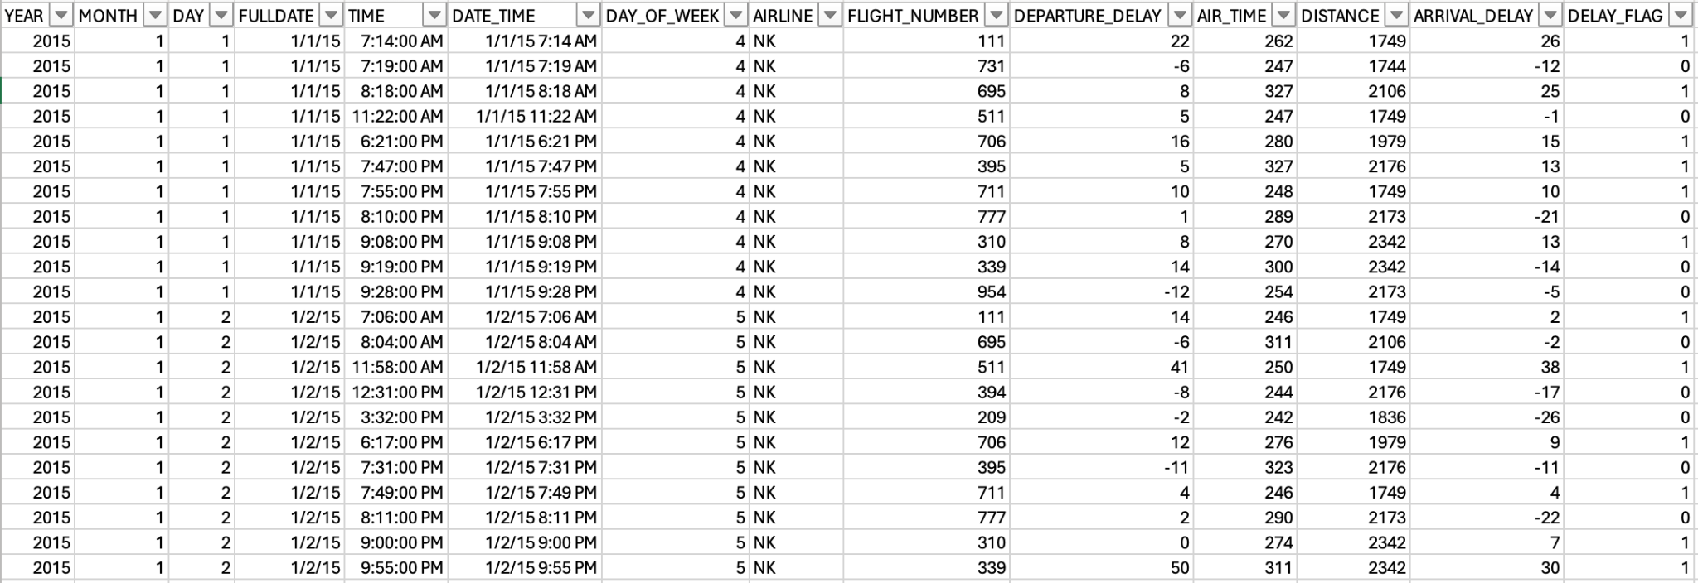
Dataset overview
Our dataset focuses on Spirit Airlines flight information that are over 4 hours during 2015.
We created a Delay_Flag variable indicating if the flight was delayed from its scheduled arrival time represented by 0s and 1s.
https://www.kaggle.com/datasets/usdot/flight-delays?select=flights.csv

Slide 6
04
Random Sampling & Clustering

Slide 7
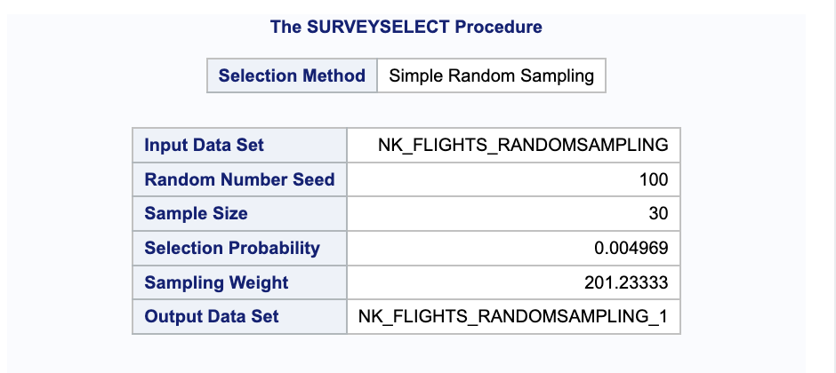
RANDOM SAMPLING
Criteria for the random sample
Sample size: 30 out of 365
Random seed: 100

Slide 8
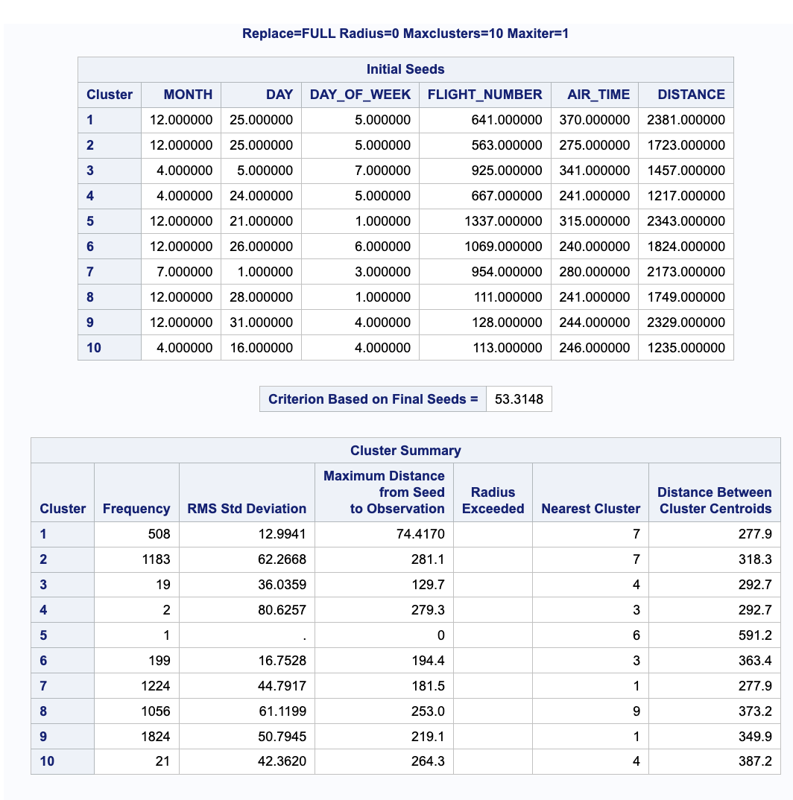
clustering
What is clustering?
Grouping together observations that have similarities based on the amount of categorical independent variables
K-means clustering: calculate a similarity of each observation and those that have high degrees of similarity will collapse together as a cluster
Independent variables
Day of Week, Flight Number, Air Time, Distance, Month, Day

Slide 9
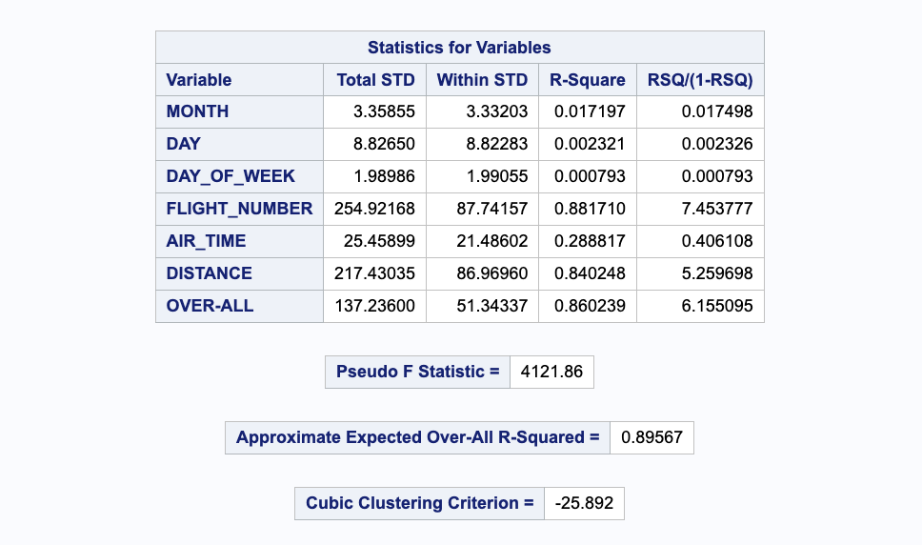
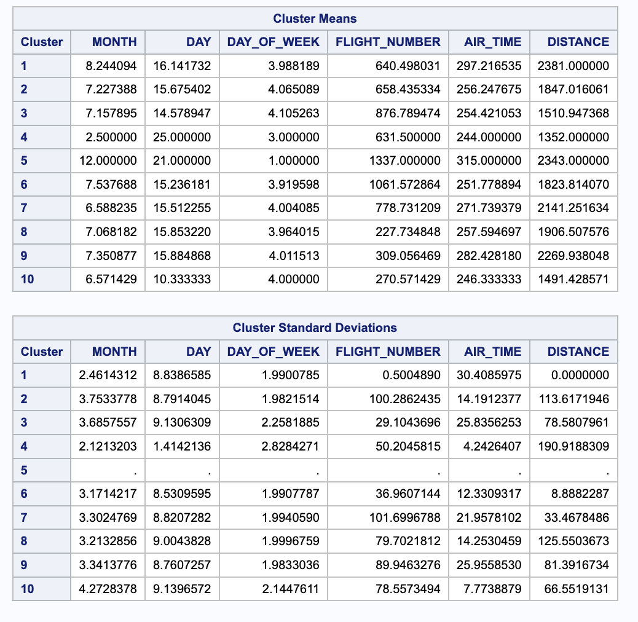
clustering
The R-squared value for this K-means clustering analysis is 0.896, which is considered very high. This means 89.6% of the variance is explained and accounted by the clusters.
The Flight Number and Distance hold the two highest R-squared values, which means that 88.17% and 84.03% of the variance are explained and accounted by Flight Number and Distance, respectively.
Based on the data, Cluster 4 and 5 have frequencies of 2 and 1 respectively. Cluster 4 was grouped by the 2 flights that had minimum distances together. Cluster 5 was one data point that was grouped by the Flight Number 1337.

Slide 10
05
AnOVA

Slide 11
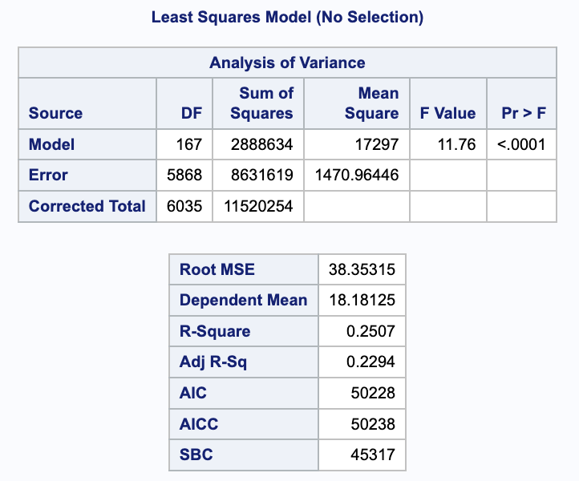
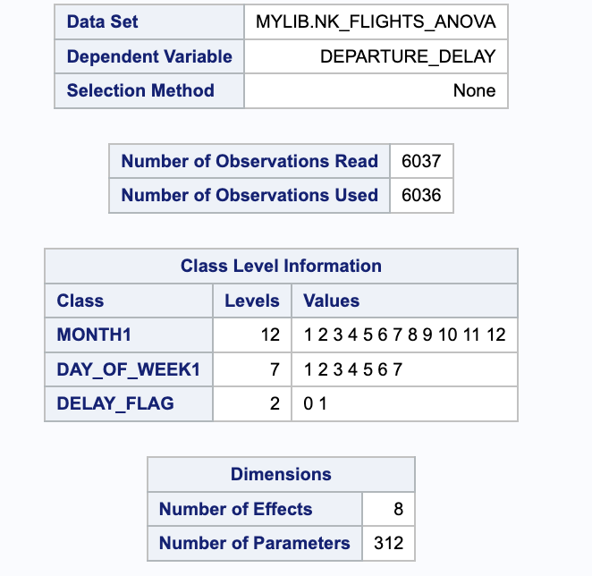
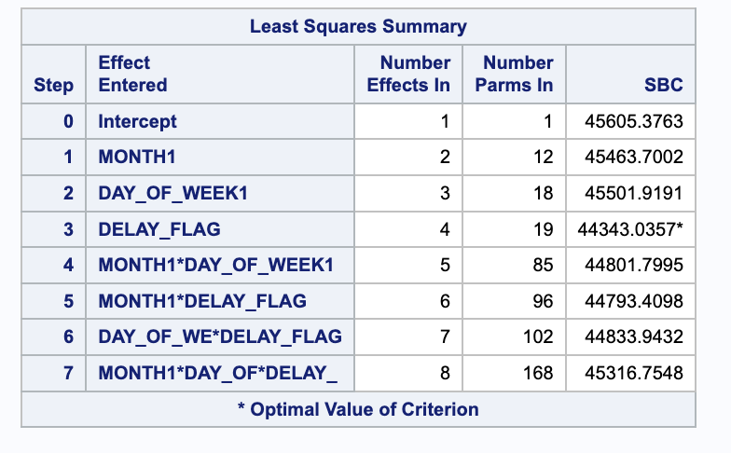
ANOVA
Steps used to achieve improvement in analysis:
These are the independent variables (with their full factorial) and the associated R-square values we used before we derive our final independent variables (all the variables we tested are statistically significant):
MONTH1, DAY_OF_WEEK1: 0.0615
MONTH1, DELAY_FLAG1: 0.0427
DAY_OF_WEEK1, DELAY_FLAG1: 0.0061
MONTH1, DAY_OF_WEEK1, DELAY_FLAG1: 0.0773
DAY_OF_WEEK1, DELAY_FLAG1, MONTH: 0.0779
MONTH1, DELAY_FLAG1, DAY_OF_WEEK: 0.07567
Due to the high number of possible combinations that are limited by SAS capabilities, we can only try a maximum of three variables. The main three categorical independent variables we considered for ANOVA are Month, Day of Week, Delay Flag. After noticing that only using variables from previous time period 1 (we also try adding previous time period 2) do not give significant R-square value, we tried combining previous time period 1 variables with current time period variables.
We found that when we use the categorical independent variables, MONTH1, DAY_OF_WEEK1, DELAY_FLAG and their full factorial, we derive a significant R-square of 0.2507 that is also statistically significant with p-value of <0.001.

Slide 12
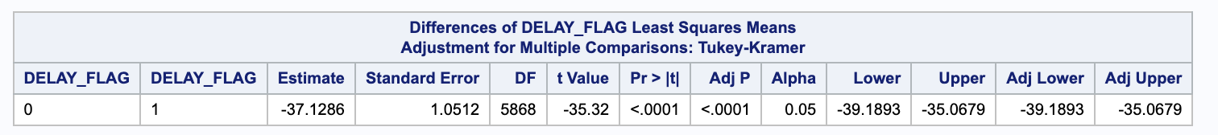
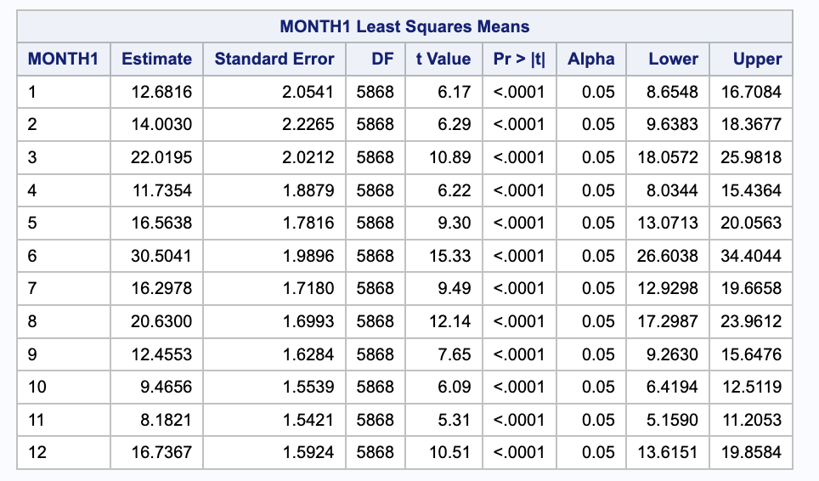
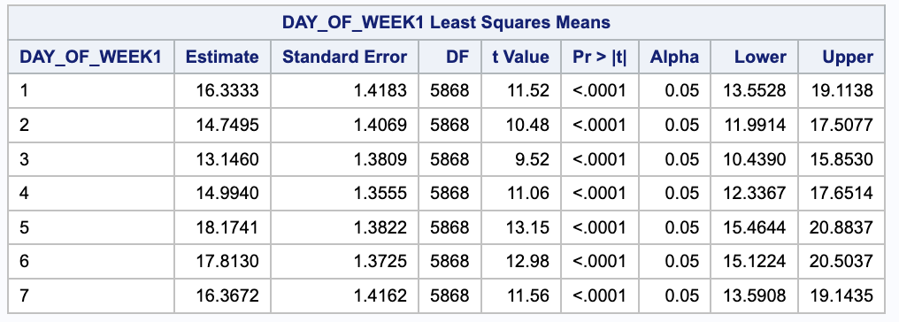
ANOVA
Since the estimate is statistically significant, we can conclude that flights with delay have a higher least square mean of 37.1286 compared to flights with no delay, depicting that on average, delayed Spirit flights experienced longer departure delays compared to non-delayed Spirit flights.
Since the estimates for all the months are statistically significant with p-value of <0.0001, we can conclude that Friday (day 5) has the highest estimate of least square mean for departure delay of 18.1741, signifying that on average, Spirit flights on Fridays, experience the longest departure delays compared to other days in a week.
Since the estimates for all the months are statistically significant with p-value of <0.0001, we can conclude that June (month 6) has the highest estimate of least square mean for departure delay of 30.5041, signifying that on average, Spirit flights in June, experience the longest departure delays compared to other months.

Slide 13
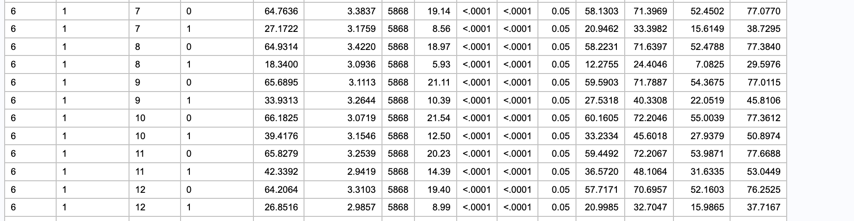
ANOVA
Since June is the month with most delays, we look into June delayed flights. Since the estimate is statistically significant, we can conclude that the least square mean for June delayed flights is 26.8516 higher than December delayed flights. This means that on average, Spirit flights in June with delays experience longer departure delays compared to Spirit flights in December with delays.

Slide 14
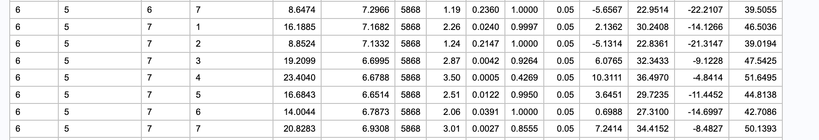
ANOVA
Since June and Fridays tend to be the month and day of week with most delays, we look into June flights on Fridays. Since the estimate is statistically significant, we can conclude that the least square mean for June flight on Fridays is 16.6843 higher than July flight on Fridays. This means that on average, Spirit flights on Fridays in June experience longer departure delays compared to Spirit flights on Fridays in July.

Slide 15
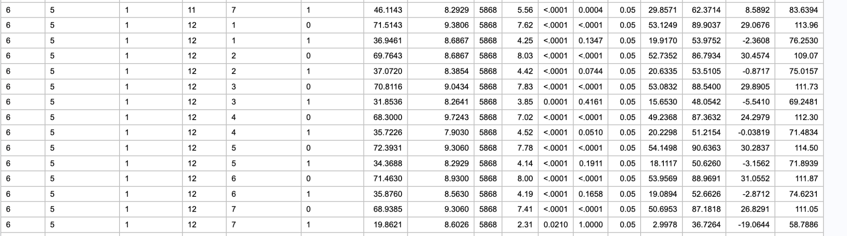
ANOVA
Since June and Fridays tend to be the month and day of week with most delays, we look into delayed June flights on Fridays. Since the estimate is statistically significant, we can conclude that the least square mean for delayed June flight on Fridays is 34.3688 higher than delayed December flight on Fridays. This means that on average, delayed Spirit flights on Fridays in June experience longer departure delays compared to delayed Spirit flights on Fridays in December.

Slide 16
06
ARIMA

Slide 17
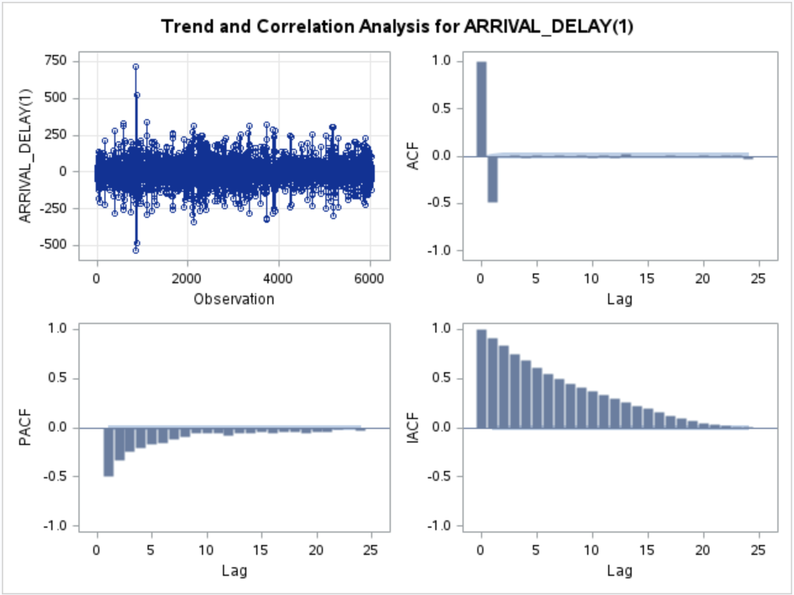
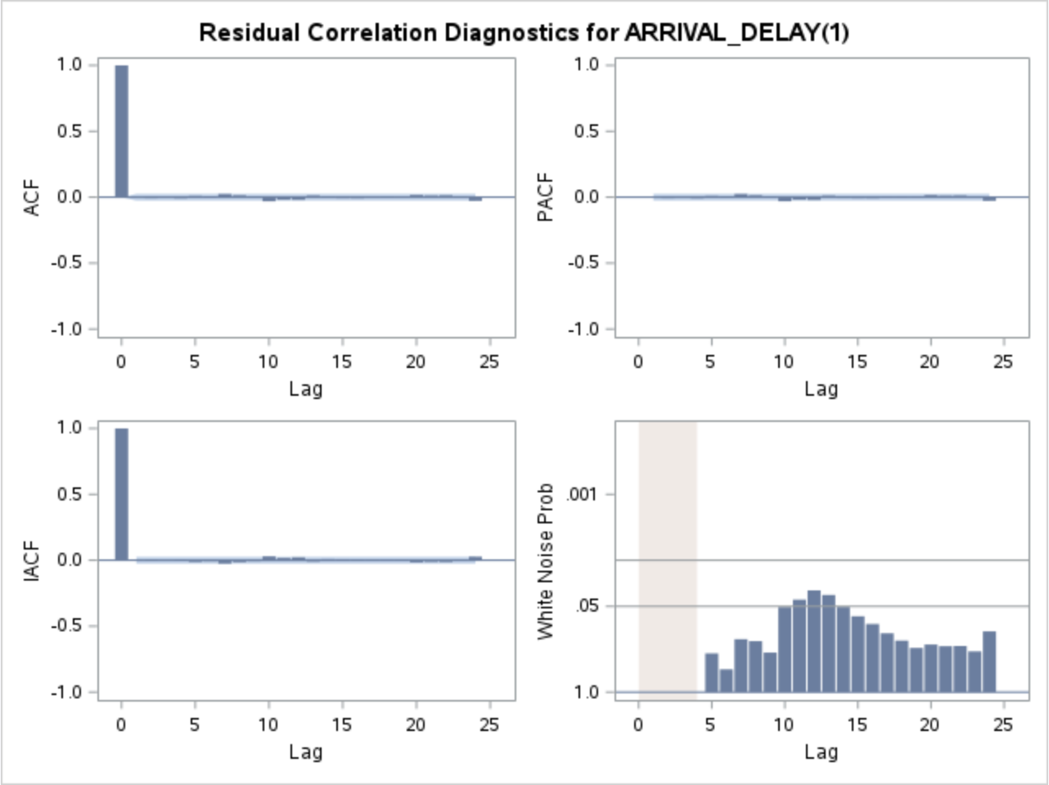
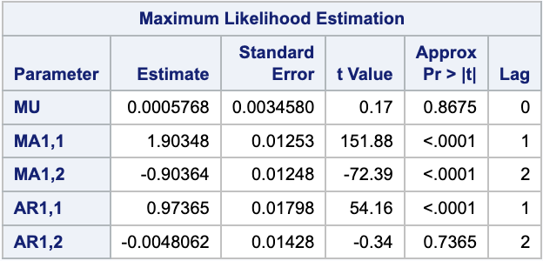
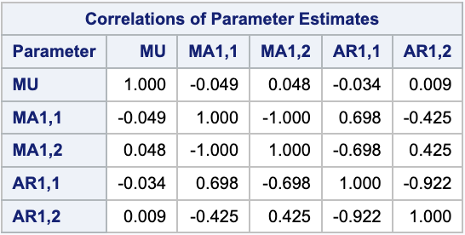
ARIMA
Based on our results, our predictive equation is:
Arrival_Delay = 0.00058*MU + 1.90*MA1,1 - 0.90*MA1,2 + 0.97*AR1,1 - 0.0048*AR1,2
Our model required differencing (d=1) to achieve stationarity. It also incorporates two past values (p=2) in the autoregressive component, indicating it uses the last two observations to predict the next value.
The moving average component (q=2) means it also uses the last two forecast errors in making predictions.
This combination suggests the model captures both the momentum and reversals in the series, adjusting for noise and seasonal effects to improve forecast accuracy.
We tested (1,1,1), (3,1,3) as well as (4,1,4) but these combinations yielded more statistically insignificant variables.
Notes:
Use the ARIMA modeling approach to create a predictive model for your dataset.
Define the ARIMA(p,d,q) modeling approach that enables your dataset to be stationary and produce an accurate predictive model.
Define the predictive equation for your ARIMA model.
Describe the steps that you applied to create your ARIMA model such as which p, d, and q values you changed and why.

Slide 18
ARIMA
From the Autocorrelation Function (ACF) graph, we can derive that the first bar is at y-axis of 1.0, this means that the revenue on a given day is correlated with itself at once, indicating a full correlation.
However after lag 0, the value reaches a negative value of -0.5, indicating that there is almost an inverse relationship for current Arrival_Delay and 2 days prior.
Sequentially, from lag 2 onwards, the values are close to 0, depicting that there is a low predictive power and there is almost no relationship.
All in all, our ARIMA(2,1,2) approach allows our dataset to be stationary and has the possibility to be an accurate predictive model.
Notes:
Use the ARIMA modeling approach to create a predictive model for your dataset.
Define the ARIMA(p,d,q) modeling approach that enables your dataset to be stationary and produce an accurate predictive model.
Define the predictive equation for your ARIMA model.
Describe the steps that you applied to create your ARIMA model such as which p, d, and q values you changed and why.

Slide 19
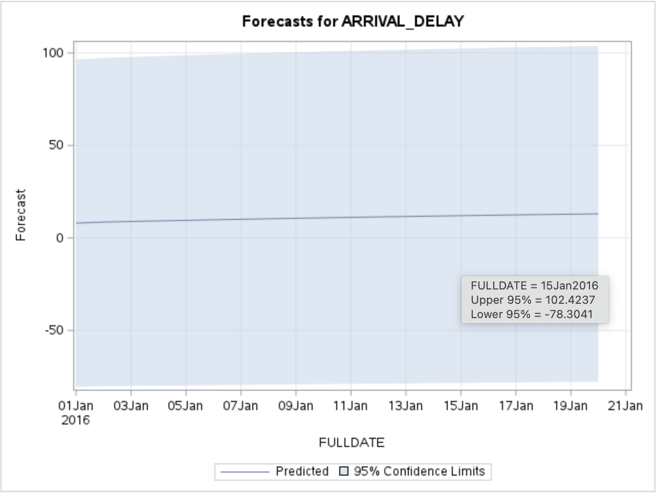
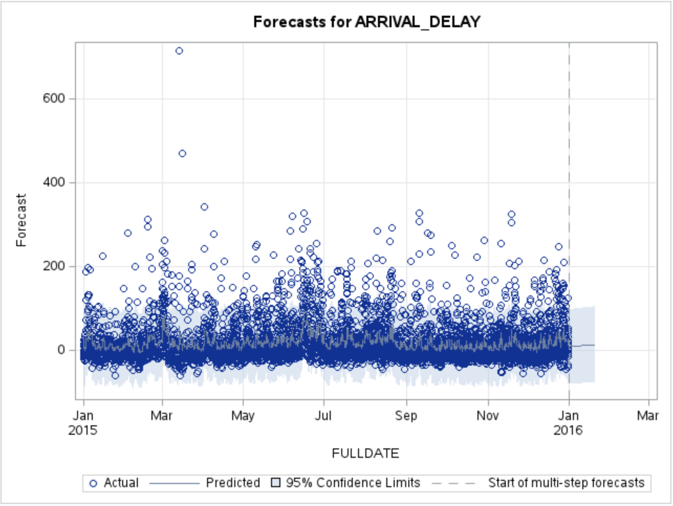
ARIMA
Our forecasting model predicts an increase in arrival delays for the next 20 periods with a uniform structure of variation. This could be because we filtered out flights that were under 4 hours, and could improve on our model if we had more data points.
Notes:
Use the ARIMA modeling approach to create a predictive model for your dataset.
Define the ARIMA(p,d,q) modeling approach that enables your dataset to be stationary and produce an accurate predictive model.
Define the predictive equation for your ARIMA model.
Describe the steps that you applied to create your ARIMA model such as which p, d, and q values you changed and why.

Slide 20
07
Binary logistic regression

Slide 21
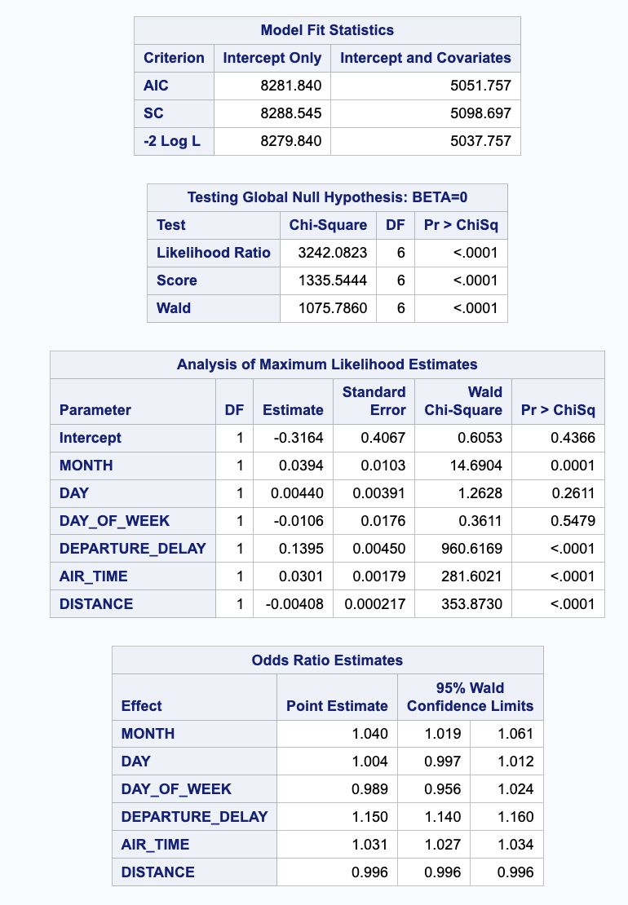
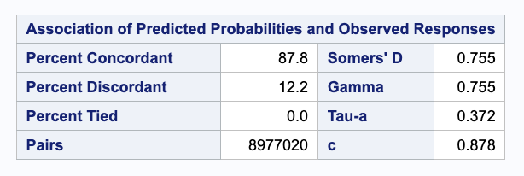
Binary Logistic Regression
Our analysis incorporated six variables (Month, Day, Day of Week, Departure Delay, Air Time, and Distance) to investigate how time of departure, air time, and distance impact delay likelihood.
Our model identified later months, departure delays, longer air times, and shorter travel distances as statistically significant variables in predicting flight delays.
We also note that our model suggests that if we were to select a random flight, there is a 87.8% chance that we would select a flight that has a delay.

Slide 22
08
CONCLUSIONS

Slide 23
Conclusions Pt. 1
Conclusion #1
Conclusion #2
Conclusion #3
Conclusion #4
A rise in departure delay notably amplifies the likelihood of subsequent arrival delays for flights. This underscores the importance of thoroughly investigating and addressing departure delays stemming from factors such as adverse weather conditions, airport system inefficiencies, and aircraft-related issues to uphold punctuality standards for Spirit flights.
An increase in flight distance correlates with a decreased likelihood of arrival delays. This relationship implies that flights covering longer distances are typically better planned to accommodate their extended travel time, reducing the probability of arrival delays.
Our autocorrelation results could give us insight to how our airline responds to arrival delays. Lag 1 shows a negative value indicating that we are eager to rectify if a previous flight was delayed. For sequential Lags, there are many factors that can contribute to the delay that cannot be predicted and have to be tackled on a day-to-day basis.
Arrival_Delay = 0.00058*MU + 1.90*MA1,1 - 0.90*MA1,2 + 0.97*AR1,1 - 0.0048*AR1,2
Given our prediction equation, the last two forecast errors in making predictions are statistically significant (MA1,1 & MA1,2) and have the 2 of the highest absolute value correlation coefficients.

Slide 24
Conclusions Pt. 2
Conclusion #5
Our ANOVA results show that flights on June and Fridays experienced the longest departure delays, compared to the rest of the month and day of the week respectively. We found that delayed June flights on Fridays have longer departure delays, compared to delayed December flights on Fridays. Even though December is known for holiday travel, June still experiences longer delays that can be attributed to people traveling for summer vacations, school holidays, graduations, weddings.

Slide 25
Thank you

